Slide 1
Augmented control of security panel through OCF standards
Group No: I3 Date: 18 / 3 / 2016
Team Members Company Name: Honeywell
Project Advisor (External) : Rajkiran B Patil (Project Lead)
Project Advisor (Internal @ Amrita) : Dr.Vidhya Balasubramanian
(Asso. Professor, Computer Science)
S.No | Reg.No | Name of the Student | Section
1 | CB.EN.U4CSE12133 | Ragul B | CSE - B

Slide 2
Problem Statement
Develop an augmented reality interfaced application for
security panel control through open connectivity
foundation (OCF) standards
Date: 18/3/2016
Project Group No: I3

Slide 3
What is Internet Of Things ?
The Internet of Things (IoT) is a system of interrelated computing devices, mechanical and digital machines, objects, animals or people that are provided with unique identifier and the ability to transfer data over a network without requiring human-to-human or human-to-computer interaction.
Date: 18/3/2016
Project Group No: I3

Slide 4
What is Augmented Reality ?
Augmented reality is the integration of digital information with the user's environment in real time. Unlike virtual reality, which creates a totally artificial environment, augmented reality uses the existing environment and overlays new information on top of it.
Date: 18/3/2016
Project Group No: I3

Slide 5
Augmented Reality can be brought about by two ways :
      Using a static tracker image
      Using dynamic tracker image
Using a static tracker image:
A pre-defined image is fed into the system such that only when the system detects that particular image, it renders the augmented layer over reality. Multiple static tracker image detection is also possible.
Using dynamic tracker image:
The system allows the user to capture the tracker image at real time and it stores the image captured in a cloud/database. Thus whenever the system detects the captured tracker image, it renders the augmented layer over reality.
Date: 18/3/2016
Project Group No: I3

Slide 6
2
Open Connectivity Foundation (OCF)
To get industry consolidation around a common, interoperable approach.
Consumers, Enterprise, Industrial, Automotive, Health, etc. who want smart devices to easily interconnect and communicate with appliances, embedded devices, etc will benefit from this approach
The approach is brought through IoTivity Project.
IoTivity is an open source software framework enabling seamless device-to-device connectivity to address the emerging needs of the Internet of Things.
Date: 18/3/2016
Project Group No: I3

Slide 7
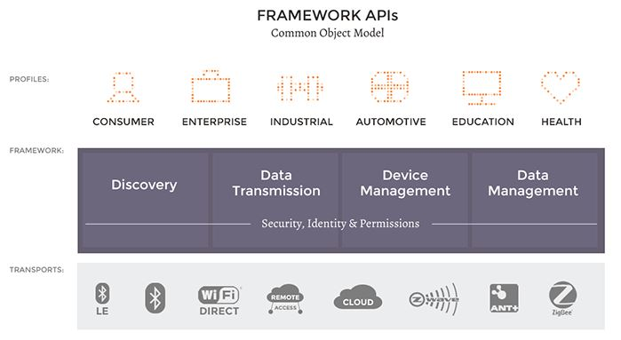
IoTivity
Date: 18/3/2016
Project Group No: I3

Slide 8
The framework operates as middleware across all operating systems and connectivity platforms and has four essential building blocks:
Discovery
IoTivity discovery supports multiple discovery mechanisms for devices and resources in proximity and remotely.
Data transmission
IoTivity data transmission supports information exchange and control based on
a messaging and streaming model.
Data Management
IoTivity data management supports the collection, storage and analysis of data from various resources.
Device management
IoTivity device management supports configuration, provisioning and
diagnostics of devices.
Date:18/3/2016
Project Group No: I3

Slide 9

Augmented App Demo
Software used : Static Tracker image :
    Unity
    Vuforia Extension
Language used :
    C#
Minimum android version :
    Android 2.3.1 “Gingerbread” (API level 9)
Date: 18/3/2016
Project Group No: I3

Slide 10
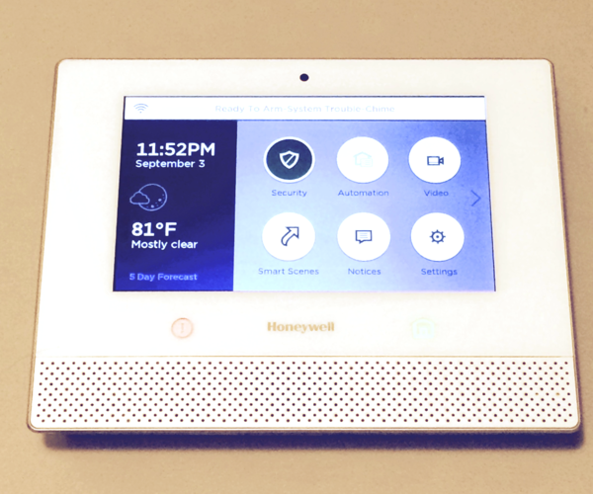
Honeywell Security Panel
Date: 18/3/2016
Project Group No: I3

Slide 11
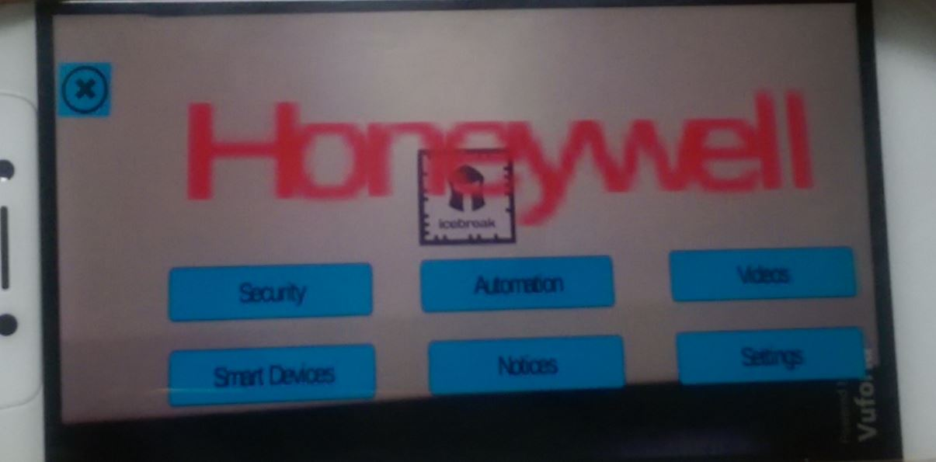
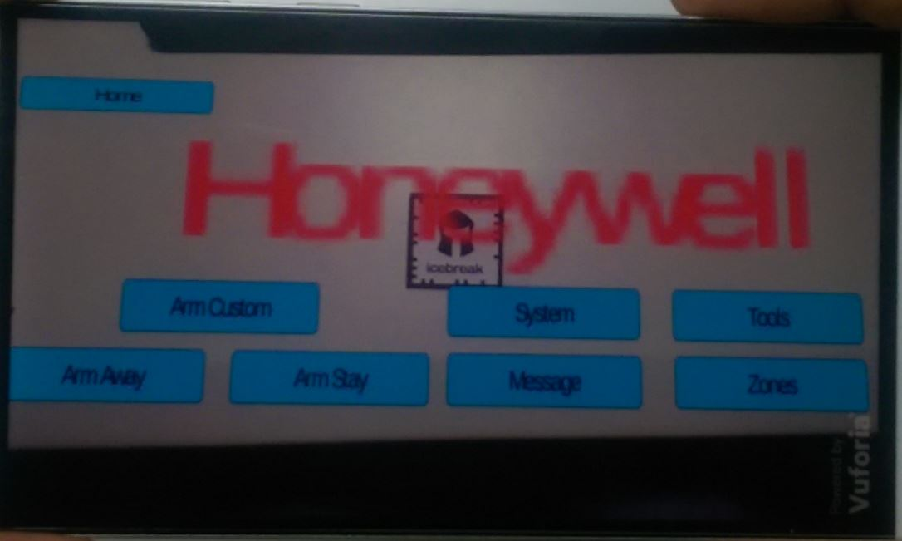
Screen-1:
Screen-2 :
Date: 18/3/2016
Project Group No: I3

Slide 12
Advantages
Right now the security panel doesn’t have an OCF stack. This IoTivity project helps build an OCF stack in the security panel, thereby easily supporting devices(resources) from other vendors.
Augmented Reality concept is tested out to find out if it can be used for panel installation or control in the future.
The user can control the security panel anywhere as long as he is connected to it and has the tracker image.
Security can be increased as we are using a particular tracker image here and the device size can be reduced as it might not need the display screen that it currently has.
Date: 18/3/2016
Project Group No: I3

Slide 13
References
“Open Connectivity Foundation”,
http://openconnectivity.org , July 2014.
“IoTivity”,
https://www.iotivity.org/, December 30, 2014.
“Internet Of Things Definition”,
http://internetofthingsagenda.techtarget.com/definition/Internet-of-Things-IoT
“Augmented Reality Definition”,
http://whatis.techtarget.com/definition/augmented-reality-AR
Date: 18/3/2016
Project Group No: I3

